Slide 1
Native American Policy
Spoiler Alert: Andrew Jackson acts unconstitutionally and a ridiculous number of Native Americans are mistreated.

Slide 2
Let’s Review
What was the nullification crisis?
What does the crisis show us about Jackson’s leadership skills and temperament as president?

Slide 3
In the 1800s…
Many Native Americans still lived East of the Mississippi River
Americans believed that the Native Americans were “uncivilized” and prevented the country from reaching its full potential
Assimilation
Removal West
Do you think the Native Americans were an obstacle that prevented the United States from succeeding?

Slide 4
The Five Civilized Tribes
Cherokee, Chickasaw, Choctaw, Creek, and Seminole
Adopted some aspects of “white” culture
Lived in the Carolinas, Georgia, Tennessee, Alabama, Mississippi
Cherokees had a written language and created a constitution based on U.S. Constitution, thus founding the Cherokee Nation

Slide 5
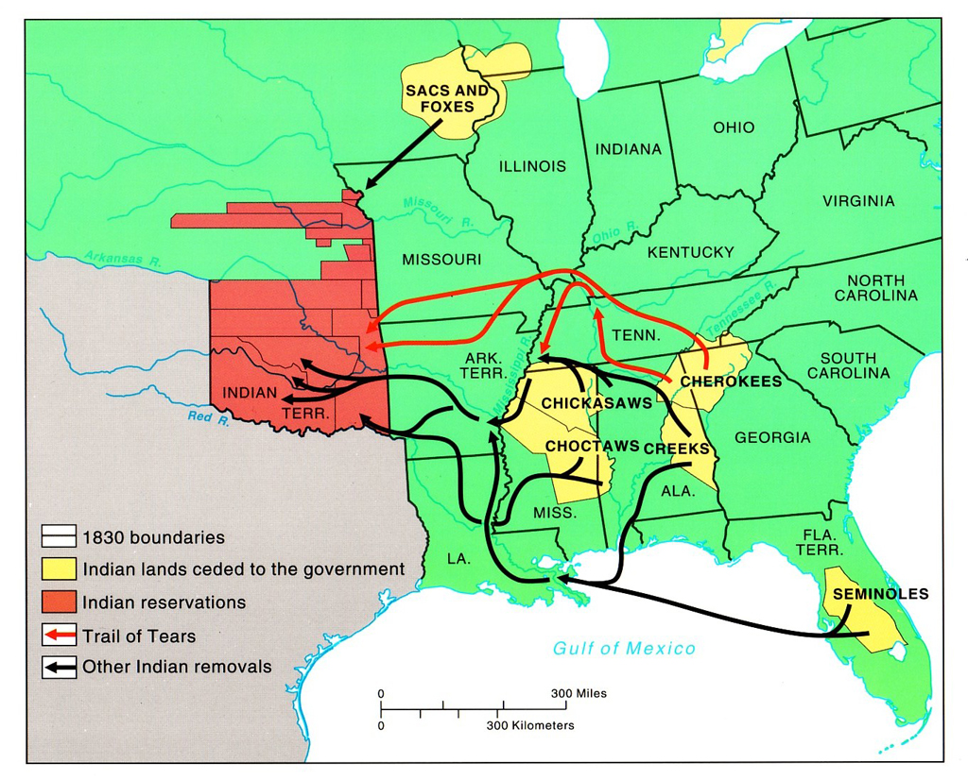
Five Civilized Tribes

Slide 6
Jackson on Native Americans
Believed the government had the power to regulate where Native Americans could live and supported a policy that relocated them west of the Mississippi River.
Did not believe that Cherokee could have their own government within the United States
In 1828, gold found in Cherokee territory in Georgia
Take a guess: What do you think states like Georgia decided to do when gold was discovered on Native American land?

Slide 7
Indian Removal Act
After heated debate in Congress, the Indian Removal Act of 1830 was signed into law by Jackson
Stated that the government could negotiate treaties that would force Native Americans to move west.
Do you think congressmen from the Northeast held opinions similar to Western and Southern representatives regarding Indian policy? Why or why not?

Slide 8
Moving Out…
Whites invaded Native American lands and forced them to agree to treaties
Native Americans given land in present day Kansas and Nebraska, which became known as the Indian Territory
What do you think happens to the Indian Territory when Americans decide that they want to expand further west to Kansas and Nebraska?

Slide 9
What About the Constitution?
The Cherokee went to the United States Supreme Court and argued that the state of Georgia could not make laws to force them to leave their homes.
The Supreme Court, led by Chief Justice John Marshall, ruled in favor of the Cherokee, stating that only the federal government could regulate Native American removal
Make a prediction: How does Jackson respond?

Slide 10
Forget Checks and Balances
Georgia and Andrew Jackson decided to IGNORE the Supreme Court
Jackson stated: “John Marshall has made his decision, now let him enforce it! Build a fire under them. When it gets hot enough, they'll go.”
If the president decided to ignore the Supreme Court today, how would we respond? What if we agreed with him and not the court, would that make a difference?

Slide 11
The Trail of Tears
Most Cherokee, led by John Ross, refused to agree to the treaties they were presented. Jackson sent troops to Georgia and 16,000 Cherokee were forced into camps.
Over the winter, the Cherokee were marched, by force, to the Indian Territory. 25% of the Cherokee died from disease and exhaustion.
Brutal treatment of the Native Americans is known as the Trail of Tears.
One soldier from Georgia wrote: “I fought through the Civil War and have seen men shot to pieces and slaughtered by thousands, but the Cherokee removal was the cruelest work I ever knew.”
Remind you of any other events in history?

Slide 12
Your Task
Read ONE of the primary sources provided and answer the following questions:
What is the goal of the speaker?
What evidence is he providing to support his argument?
What does he think the outcome of Indian Removal will be?

Slide 13
Then…
Pair up with someone who read the other source
Discuss the main points, which source is more truthful?
Do these sources help give you a better understanding of the event?

Slide 14
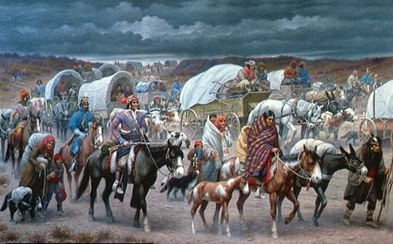
Exit Ticket
What would the United States be like today if Indian Removal or the Trail of Tears never happened?

