Slide 1
FDR and the Election of 1932

Slide 2
Do Now
1. Yes or no, is it the government’s responsibility to help individuals who cannot afford food, housing, or health care?
Why?
2. Yes or no, should the government help large businesses that are facing bankruptcy?
Why?
3. Yes or no, are Americans who depend on government assistance lazy?
Why?
4. Yes or no, is it the government’s duty to make sure that businesses are acting responsibly?
Why?

Slide 3
What’s Happening in 1932?
23.6 percent of the country is unemployed
Nearly half a million farms foreclosed
President Hoover reluctantly signed the Emergency Relief and Construction Act
Why do you think President Hoover agreed to sign relief legislation in 1932?

Slide 4
Who were the Candidates in 1932?
Republican Party- Herbert Hoover
Party blamed the economic depression on Europe
Anti-federal relief
Pro-Laissez-faire
Based on their political beliefs, what types of voters would agree with the Republican Party in 1932?

Slide 5
The challenger
Franklin Delano Roosevelt
Wealthy family, cousin of former President Theodore Roosevelt
Democratic governor of New York
Pro-government relief, promised the American people a “new deal”
What do you think attracted voters to FDR?

Slide 6
The Campaign
FDR traveled the country and delivered more than 60 speeches
FDR used campaign slogan “Kick Out the Depression with a Democrat”
Hoover was often heckled at speeches and rallies
Republican Party used “Play it Safe with Hoover” as a slogan
Before television, how do you think voters got information about the candidates?

Slide 7
Concerns about FDR
FDR contracted polio and relied on crutches or a wheel chair, some questioned if he was capable to be president
Republicans believed he was too liberal and a risk taker
Rumors were spread that he was a socialist
Why do you think Hoover’s campaign tried to scare voters away from FDR? Is this common in American politics?

Slide 8
The Results
FDR squashed Hoover in the election
Wins 57% of the vote to Hoover’s 40%
472-59 in the electoral college
Democratic Party becomes the party of the working-class and minorities

Slide 9
Electoral Breakdown

Slide 10
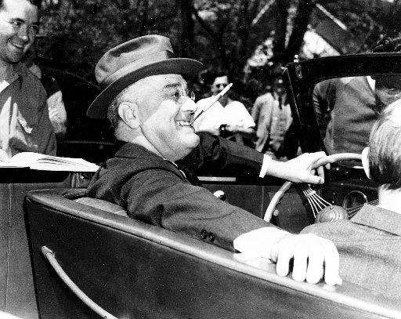
The Inauguration
Roosevelt urges optimism
Promises to bring relief to unemployed, hungry, homeless, and struggling Americans

Slide 11
The First Inaugural Speech
http://www.youtube.com/watch?v=oblTN1ojsAA
“…the only thing we have to fear is fear itself…”
FDR believed the government must act quickly to help Americans
Believed that as president, he would need as much power and authority as a war-time president to solve the economic depression
What grabs your attention when listening to his speech?
Do you agree that FDR needed nearly unlimited power to address these problems?

Slide 12
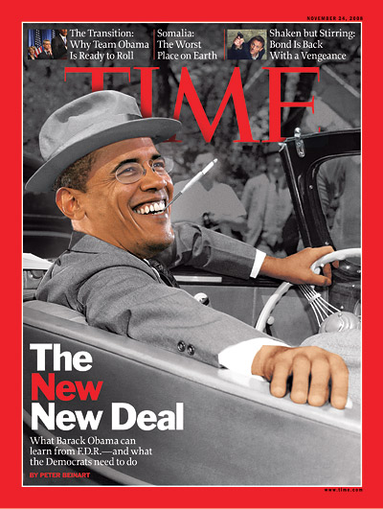
2008 Connection?
FDR and Obama won with solid majority of the vote
Elected during economic chaos
Optimistic attitudes, gifted public speakers
Attracted new voters

Slide 13
Quiz
This photo was taken in 1932. Using what you know about conditions during the Great Depression and the challenges facing FDR, write a diary entry from the perspective of one of the people in this picture about what they were hoping FDR would accomplish.

