Slide 1
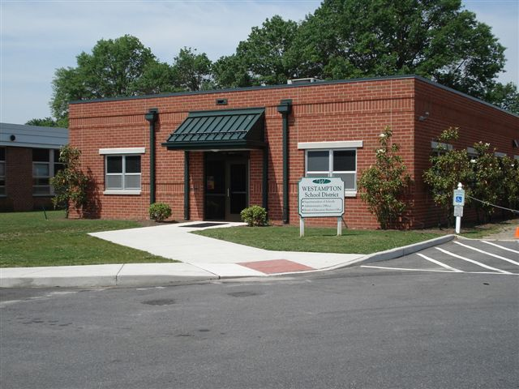
WTPS Annual Goals 2016-2017
Westampton Township Public Schools
2016-2017 District and
Board of Education Goals
Presented by:
Virginia Grossman, Superintendent
August 8, 2016

Slide 2
District Goals
As outlined by the New Jersey School Board Association, our Westampton Township Public Schools Board of Education is responsible for establishing goals for our public schools based on student educational needs, parent and community aspirations, state and federal standards and district financial resources. Our Board of Education sets annual District and Board goals.

Slide 3
District Goal 1:
Student Achievement: The Westampton Township Public Schools will utilize District Data Teams to work with staff to analyze students’ success is all facets of school life, from assessment data and curricular viability, to attendance and discipline data. Through implementation of data-driven, strategic actions, student achievement will increase by an average minimum of (three) 3% in each subject area of our state mandated assessments (PARCC).

Slide 4
District Goal 2:
Human Resources: The Westampton Township Public Schools will promote equity by continuing efforts to recruit and retain a staff that is ethnically and culturally diverse, ensuring that all search committees see this as a key district goal. Annual recruitment data, student teaching placements and hiring data will be reviewed and analyzed.

Slide 5
District Goal 3:
Community Engagement: The Westampton Township Public Schools will engage the community in support of the district’s strategic plan, and equity and diversity goals. Attendance at events and annual survey completion data will be compiled and assessed to support enhanced community engagement.

Slide 6
District Goal 4:
Fiscal Responsibility: The Westampton Township Public Schools will maintain the financial integrity of our district while providing quality programs that meet or exceed the needs of all students by maintaining a balanced annual budget, reviewing student enrollment monthly and prioritizing funds in order to support the continued development of curriculum and student instruction.

Slide 7
Board Goals
Representing our community’s philosophy of education, Board of Education Goals become the guidelines for making and evaluating sound decisions that affect the governance of our schools.

Slide 8
BOE Goal 1:
Student Achievement: The Westampton Township Board of Education will review disaggregated data from our District Data Teams. Assessment data analyses and cohort analyses will be part of our State of the Schools report.

Slide 9
BOE Goal 2:
Human Resources: The Westampton Township Board of Education will support equity in ethnic and cultural diversity, enlisting the support of our community in attracting and retaining staff reflective of our student demographics.

Slide 10
BOE Goal 3:
Community Engagement: The Westampton Township Board of Education will oversee production of a School District to Community communiqué to highlight our schools, engage the community in strategic planning goals, provide enrollment information, and enhance parent and community opportunities for input on school related decisions.

Slide 11
BOE Goal 4:
Fiscal Responsibility: The Westampton Township Board of Education will exhibit a forward-thinking philosophy by overseeing a minimum unassigned balance in its’ general fund ranging from one (1%) to three (3%) percent of the subsequent year’s budgeted expenditures and outgoing transfers.

Slide 12
Thank you!

